Slide 1

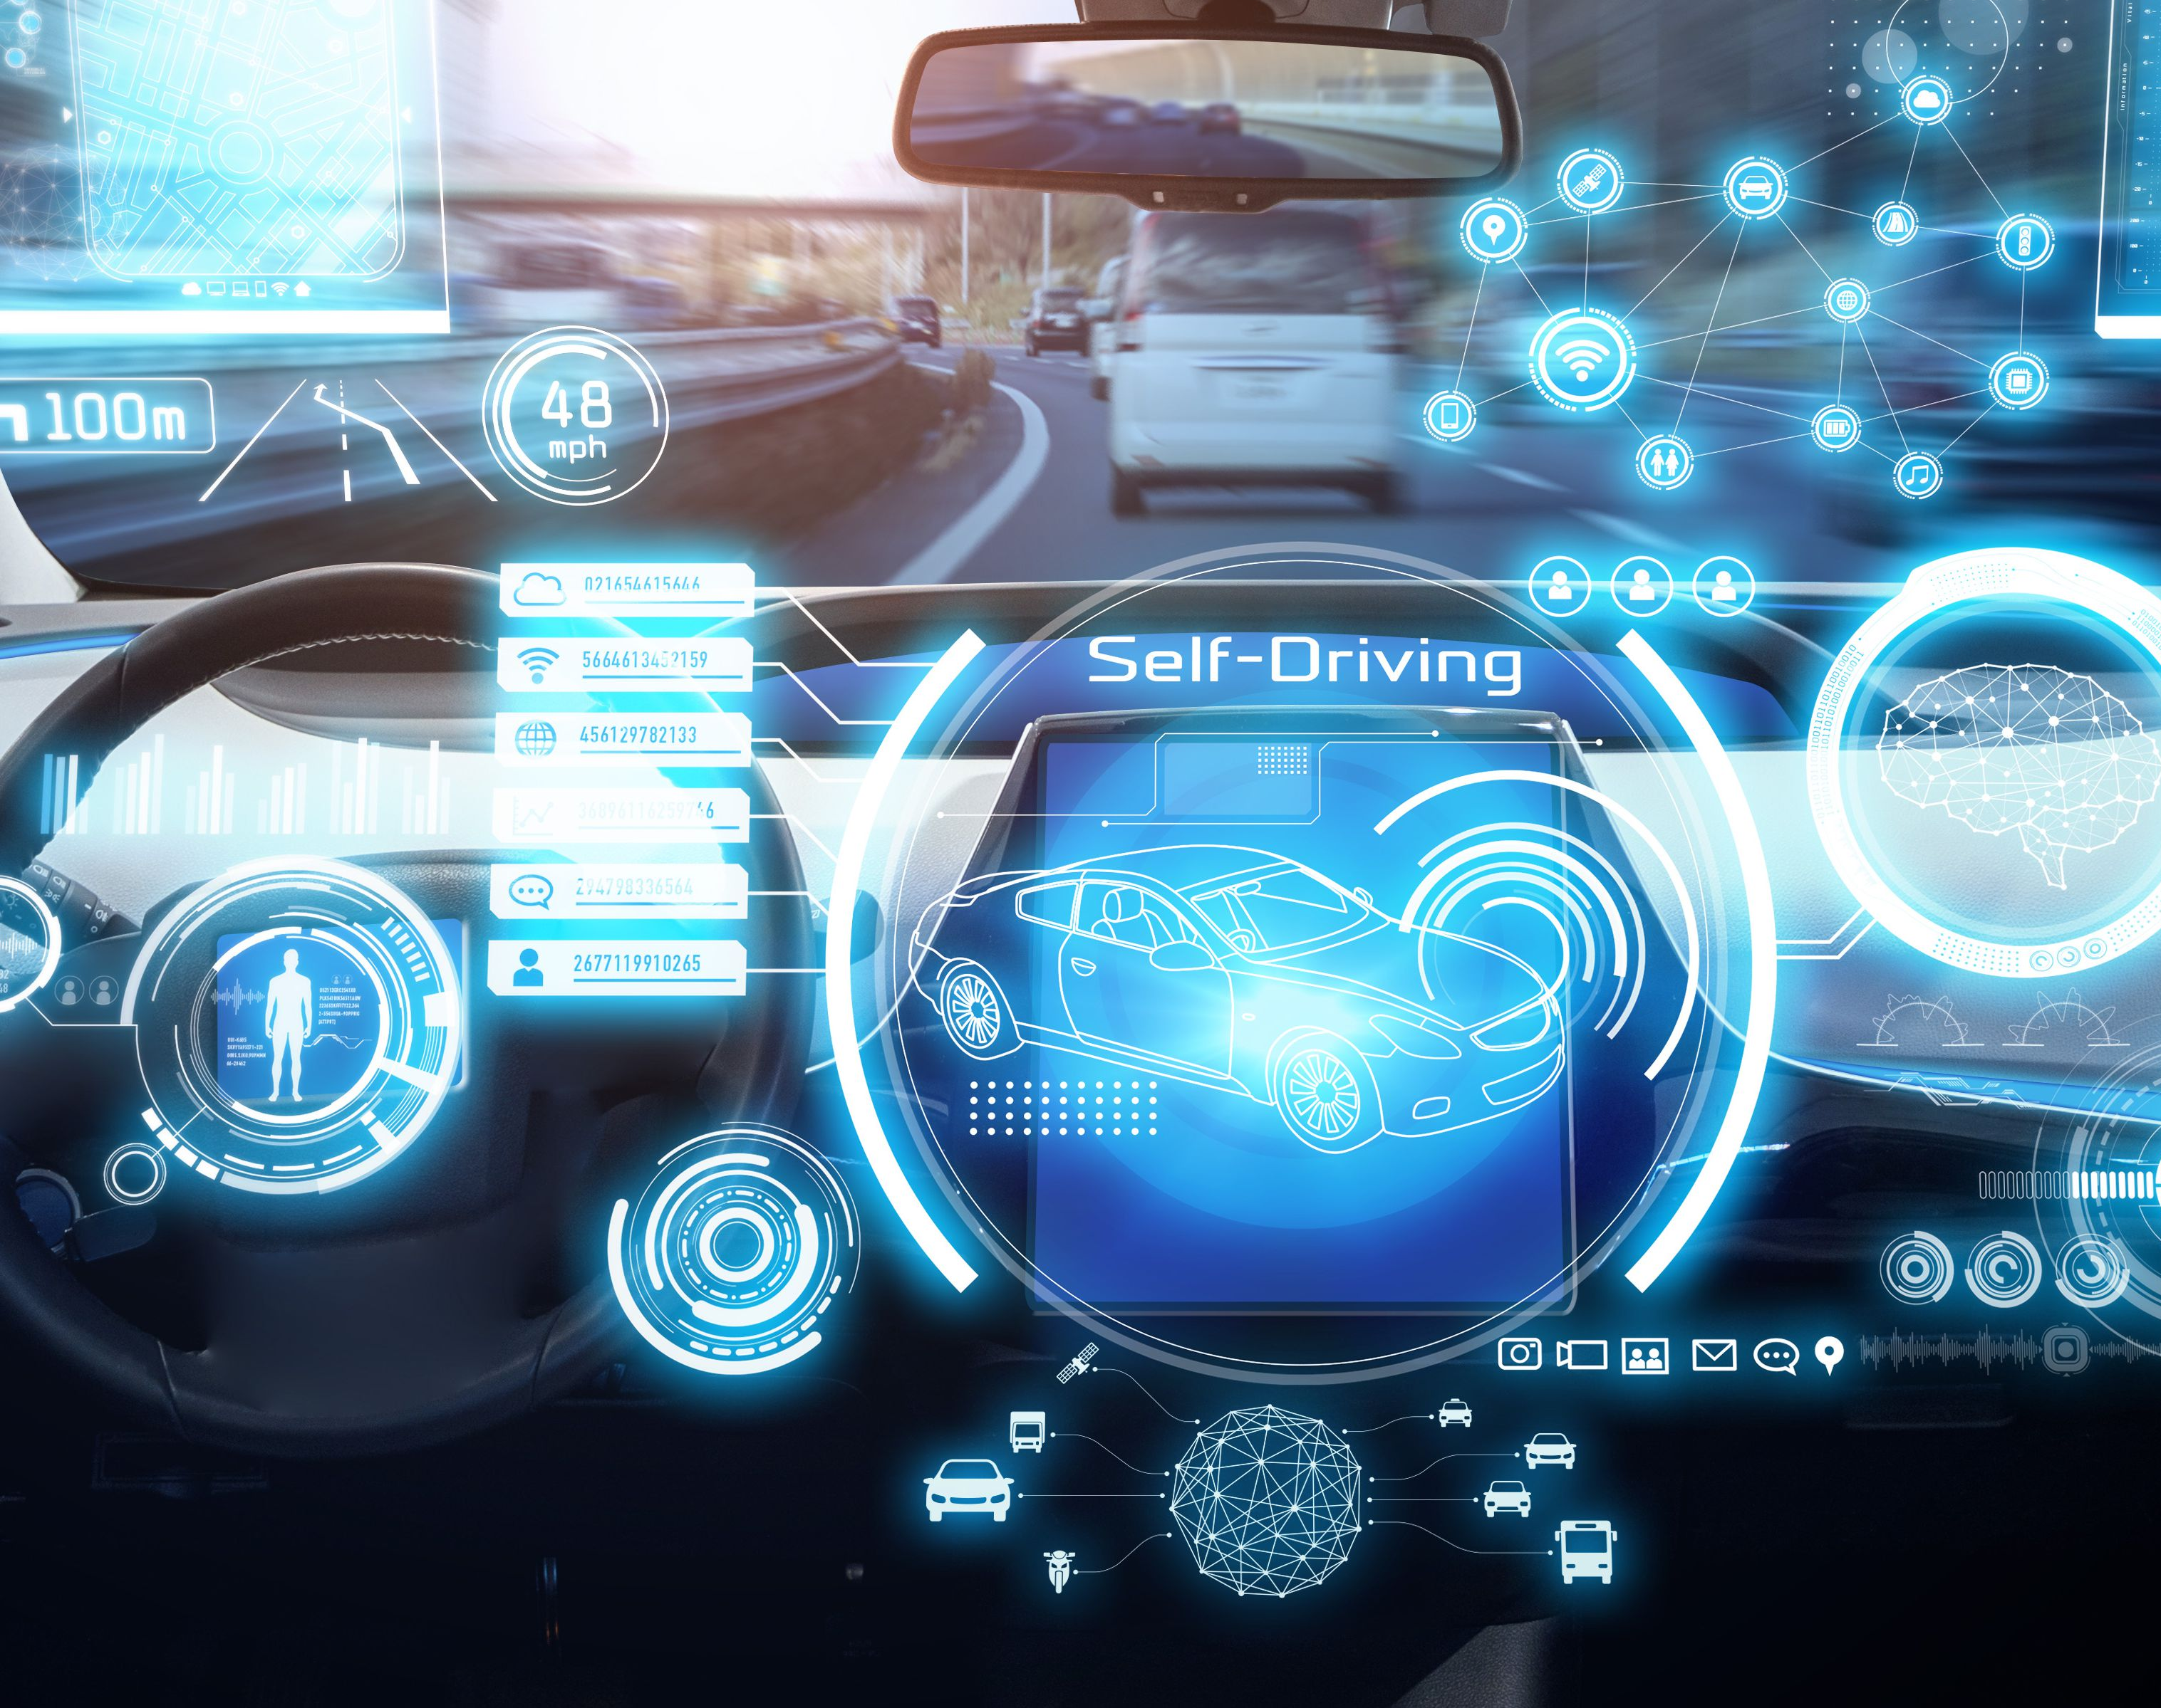
Smart Steering Robot for Autonomous Vehicle In Reverse Parking
Gaurav Kumar Gautam
(SM21MTECH12013)
Supervisor :- Dr. Venkatesham B

Slide 2
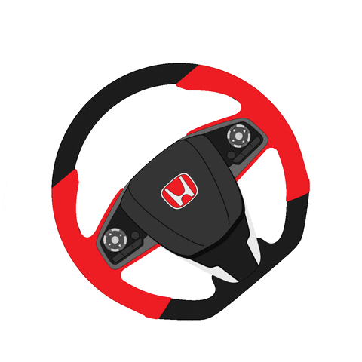
Why do we need a smart steering system?
Future of driver safety
Communication with the vehicle
To make safer and more efficient
Reduce road crashes
Smart Steering

Slide 3
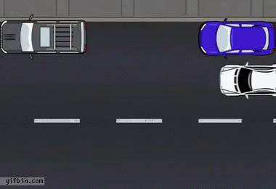
Problem Statement
Developing the smart steering control system for vehicle reverse parking

Slide 4
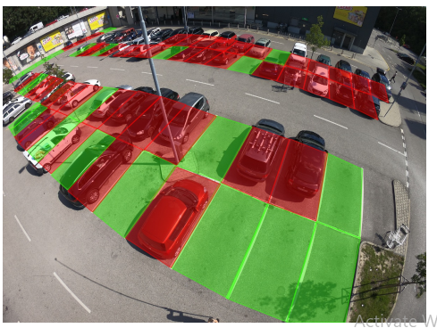
What I did till now?
Trained a model for finding the occupancy of parking
Based on Image-base dataset(ACPDS)

Slide 5
Introduction
Live information about parking space occupancy
Two common approaches to monitoring the occupancy of individual parking spaces
Installing a sensor on every parking space
Using a camera to monitor multiple parking spaces
Using an Image-Based model
An image can be captured using a long exposure time
Good color reproduction even in low-light

Slide 6
Image Based Model Dataset
New dataset used for parking space occupancy
Action-Camera Parking Dataset (ACPDS)
To improve and correctly test for model performance on previously unseen parking lots
Captured 293 images containing 11,236 unique views of a parking space, spread across tens of different parking lots and streets
Used 231, 35, and 27 images for the train, validation, and test sets, respectively

Slide 7
Models
These models are inspired by object detectors
Single-stage and two-stage object detectors rely on non-maximum suppression with an arbitrary IoU threshold for detection
For unoccluded parking spaces, needs a high IoU threshold
For heavily occluded parking spaces, need a very low IoU threshold
Use two-stage object detector models to find out the parking space location:-
R-CNN
Faster R-CNN FPN

Slide 8
R-CNN
First, pool image patches corresponding to each parking space
After that patches are separate passes through a binary classifier(ResNet50)
Output of this classifier is the occupancy score for each parking space
Number of region proposals is large (2,000), and the pooling resolution of each patch is high (224 x 224)
we usually pass at most around 100 image patches through the classifier
Disadvantage of this model is:-
No information can flow between pooled images patches

Slide 9
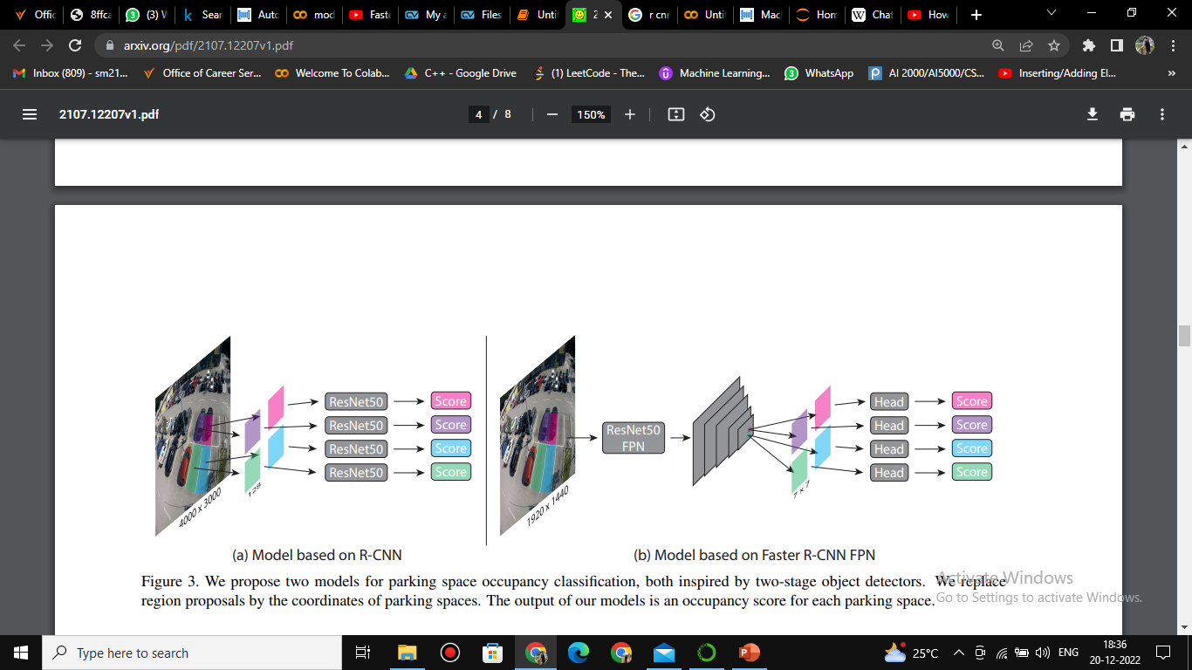
Model of R-CNN

Slide 10
Faster R-CNN FPN
First, pass a resized image through a ResNet50 combined with a feature pyramid network
After that pool features corresponding to each parking space from the feature pyramid
Pass them separately through a classification head to obtain the final occupancy score
Use pooling resolution (7 x 7)
This architecture allows for information flow between parking spaces

Slide 11
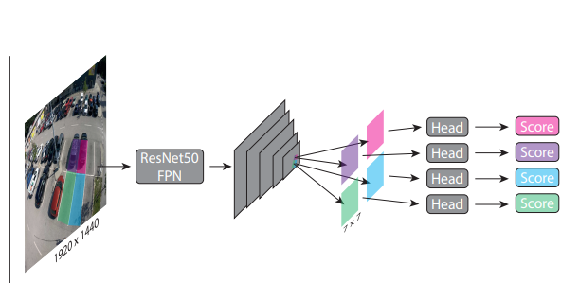
Model on Faster R-CNN FPN

Slide 12
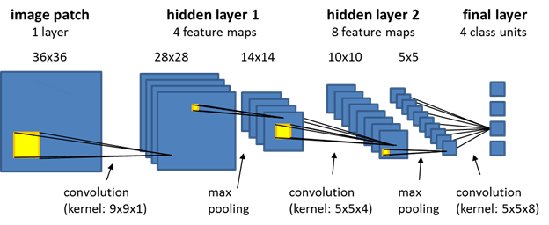
Convolution Neural Network Working

Slide 13
Pooling
Models rely on pooling features
Annotate each parking space using a quadrilateral
First pooling method is
To warp the pixels inside each quadrilateral and project them to an (S x S) patch directly
Second pooling method is
A minimum bounding square around each parking space annotation and interpolate this square to an (S x S) patch
Notable difference between is
one only pools information from within a parking space quadrilateral
while the other also pools information from surrounding pixels

Slide 14
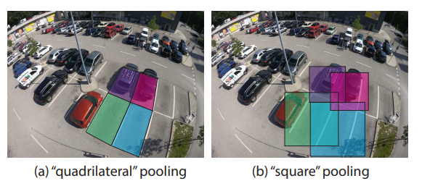

Slide 15
Evaluation
Trained both models with different hyperparameter configuration
Both models use pre-trained ResNet50 backbone
R-CNN uses weights from ImageNet while Faster R-CNN FPN uses weights from the COCO dataset
Use SGD with momentum optimizer than adaptive methods

Slide 16
Results
Trained both models 5 times in each configuration, each time with random initialization
Tested both models on both pooling methods
R-CNN uses 3 pooling resolutions (64, 128, 256)
Faster R-CNN FPN uses 3 pooling resolutions (800, 1100, 1440)
With the highest validation accuracy is highlighted for both architectures
Faster R-CNN FPN architecture performs better than the R-CNN architecture

Slide 17
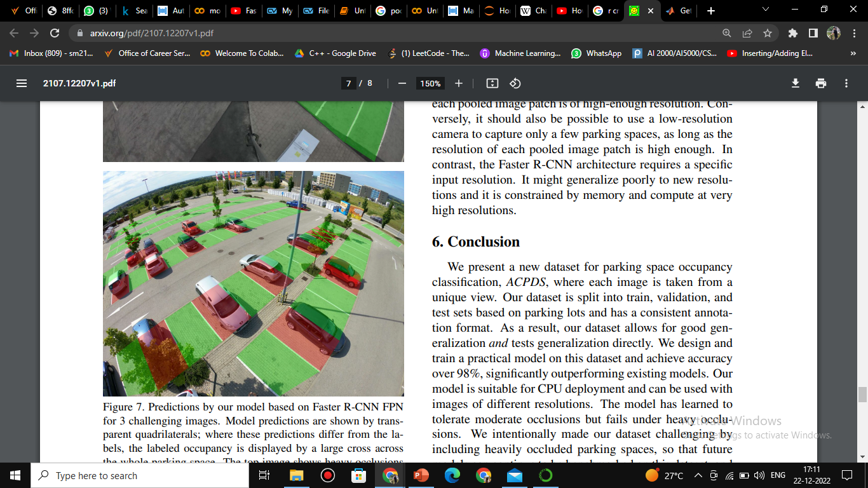
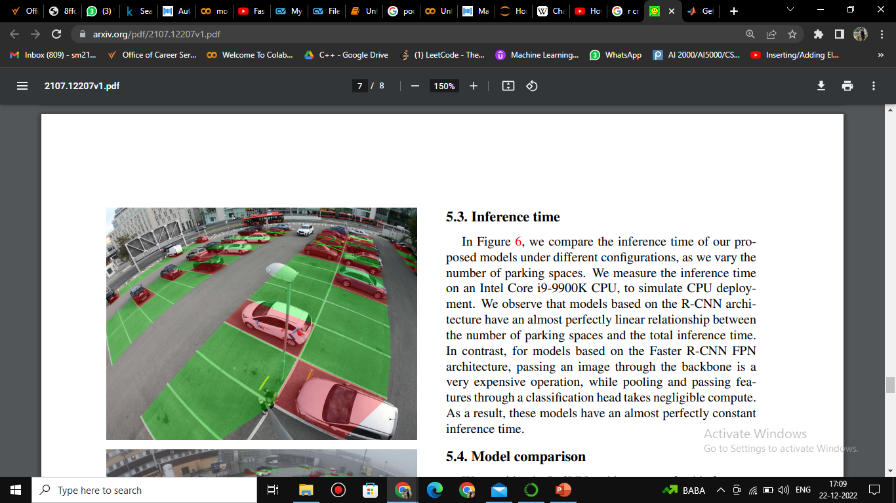
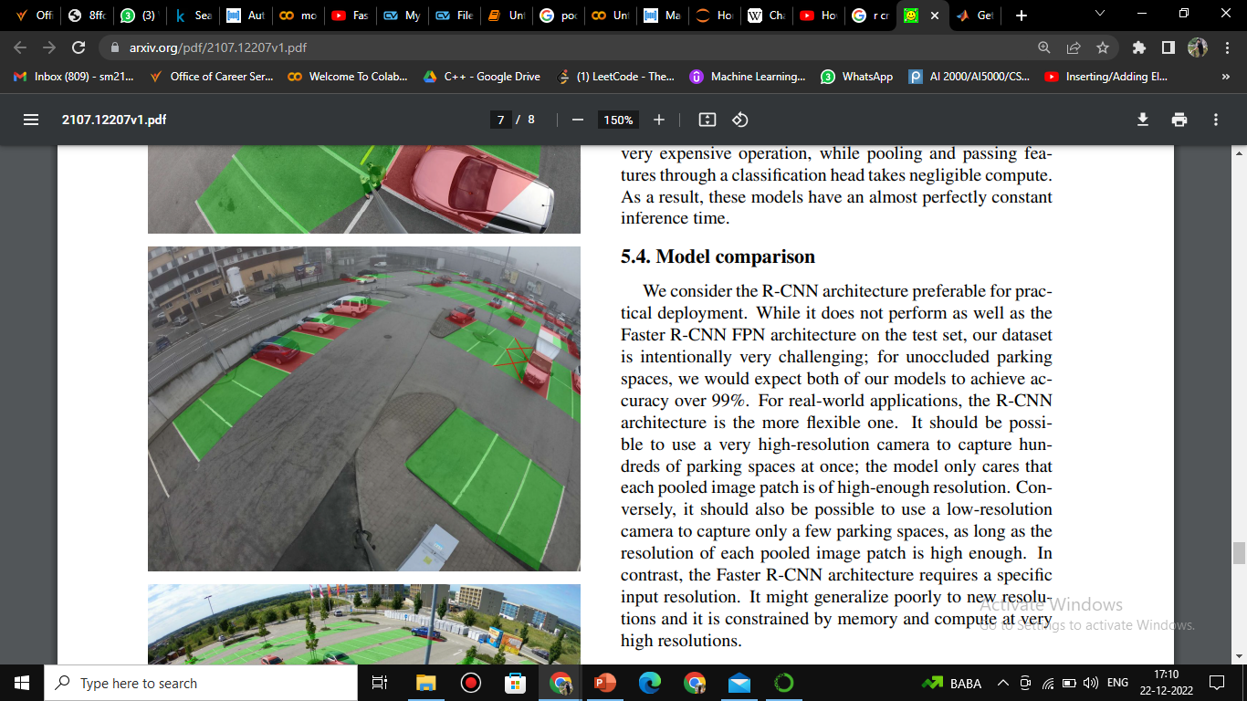
Predicted by Faster R-CNN FPN

Slide 18
Reverse Parking
Automatic parking technology can complete parking operations safely and quickly without a driver and can improve driving comfort, while greatly reducing the probability of parking accidents
Currently research is based on two methods:
Ultrasonic sensor
Based on Visual Sensor
Existing automatic parking systems have two major problems
Parking scene recognition less intelligent
Vehicle control has a low degree of automation

Slide 19
Reverse Planning method of Autonomous Parking path
Traditional parking path planning method based on geometric curve
High real-time performance
High requirement for initial parking position
With the reverse planning method
According to the location of the target point
According to collision constraints
According to parking space constraints
Prerequisition of Parking path

Slide 20
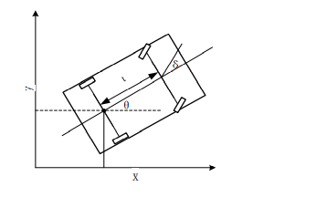
Parking Path Planning
Constraints of the vehicle parameter and kinematics characteristics
Use of rectangles for simplifying the kinematic analysis process
At low speeds, the vehicle can be regarded as a rigid body
Five Parameter [x, y, θ, κ, v]

Slide 21
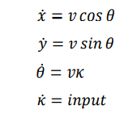
𝜃 is the current heading of the vehicle
𝜅 is the curvature of the path
The change rate of vehicle heading 𝜃 and vehicle longitudinal speed 𝑣 are expressed as a function of driving distance S
According to the Ackerman Steering model

Slide 22
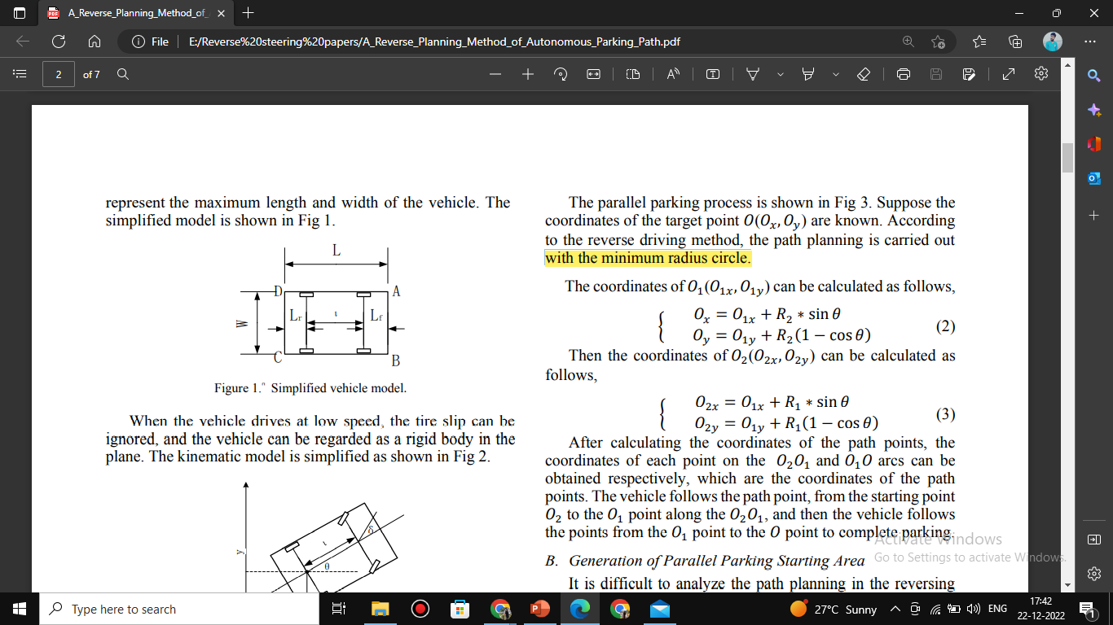
Analysis of Parking Process of Parallel Parking Spaces
Coordinates of the target point 𝑂(𝑂𝑥,𝑂𝑦)
Path planning is carried out with the minimum radius circle

Slide 23
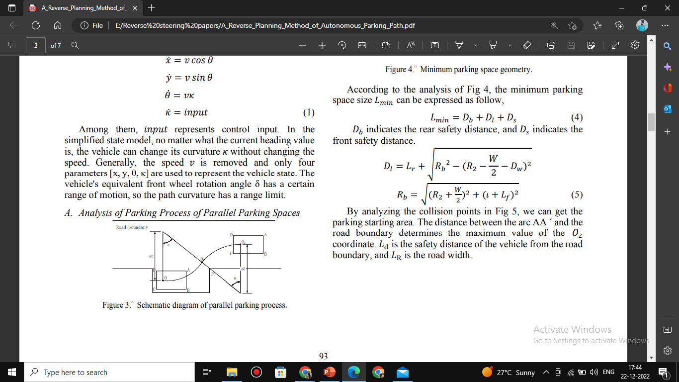
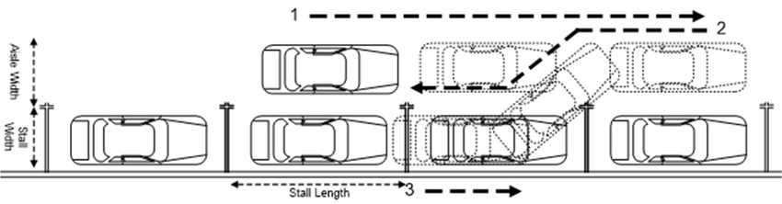

Slide 24
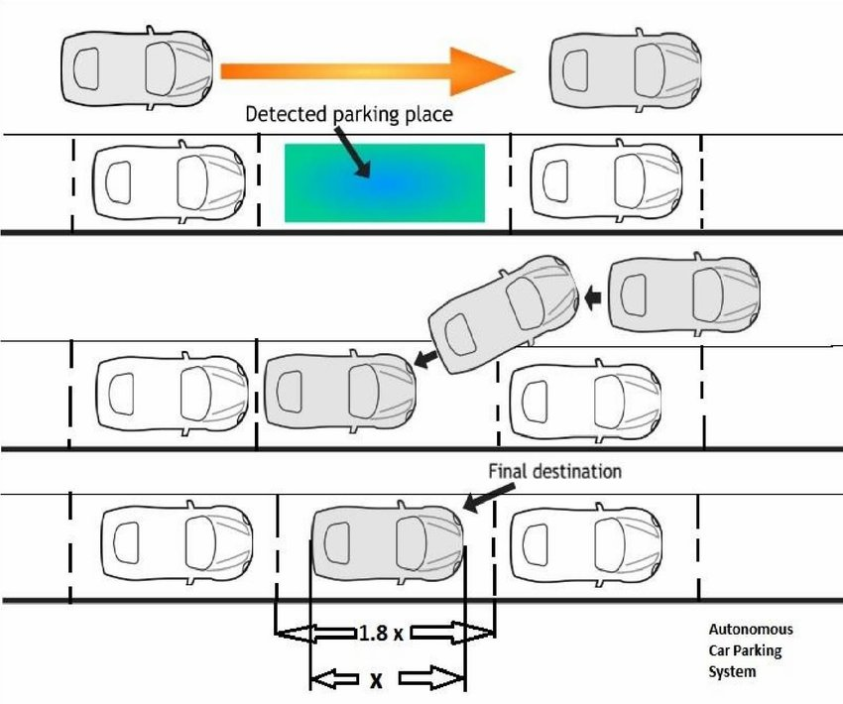

Slide 25
Future Work
Sensor fusion for lane detection and obstacle detection
Steering angle calculation in reverse parking
Implementation of the algorithm in a virtual environment
Implementation of hardware (4th sem)

Slide 26
References
https://www.researchgate.net/figure/Parallel-Parking-Process-Undefined-Space_fig3_333001953
https://arxiv.org/pdf/2107.12207v1.pdf
https://www.pinterest.com/pin/393431717446339860/
A_Reverse_Planning_Method_of_Autonomous_Parking_Path.pdf
https://docs.ecognition.com/eCognition_documentation/Reference%20Book/02%20Algorithms%20and%20Processes/9%20Deep%20Learning%20%28CNN%29%20Algorithms/Deep%20Learning%20%28CNN%29%20Algorithms.htm

Slide 27


